Slide 1
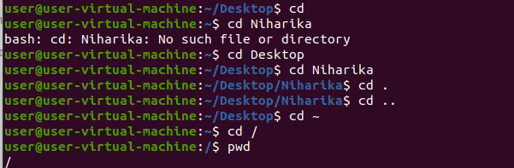
UNIX COMMANDS
Cd = It is used to change the current directory
Cd .. = to navigate up one directory
Cd ~ = it displays the home directory
Pwd = it prints the path of the working directory
Cd /= used to change the directory to root directory
Cd . =used to indicate the current directory

Slide 2
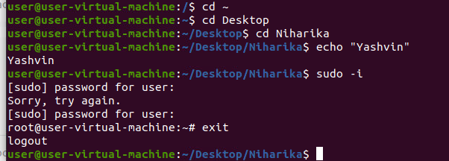
Echo = used to display the line of text that are passed an argument
Sudo -I = used as prefix of some commands that only superuser are allowed to run
Exit= used to exit the current directory

Slide 3
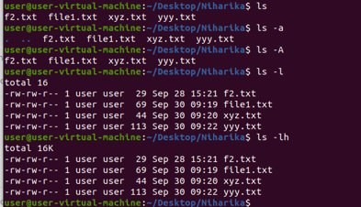
Ls = it lists the directory contents of files and directories
Ls –a= hidden files start with dot symbol they are not visible in the regular directory
Ls –A = used to show the hidden files
Ls –lh = used to show the files in human readable form
Ls –f= it classifies the file with different special character

Slide 4
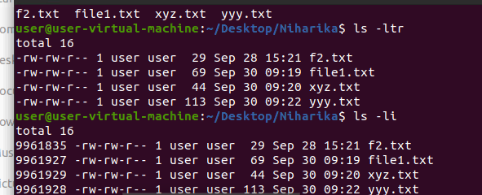
Ls –lt = to sort the filenames displayed in the ordered of last modification time
Ls ltr = it displays the list files with ionode

Slide 5
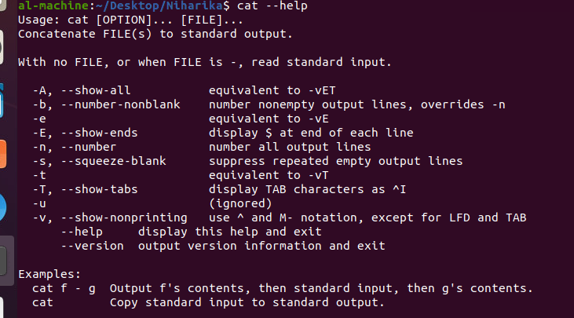

Help = help commands is useful as it name says help you to larn about any built –in command who = used to get information about current logged inn user or system whoami = it is a basically concatenation of the strings

Slide 6
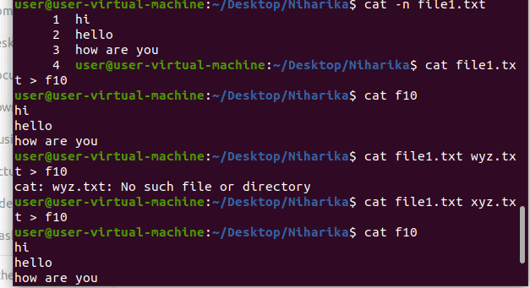
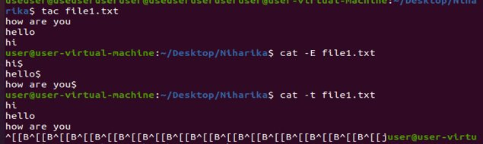
Cat –s filename= reads data from the given in the command cat –E= it shows the $ symbol at the line cat –t filename= useful to know where tab used

Slide 7
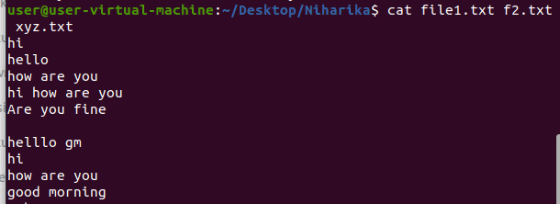
Cat filename > newfile=it reads data from the given in the command cat file1.file2= it reads data from the all the files given in the command and gives their content as output in line order

